Slide 1
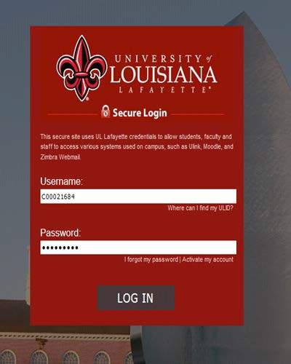
NEW STATEMENT OF ACCOUNTS

Slide 2
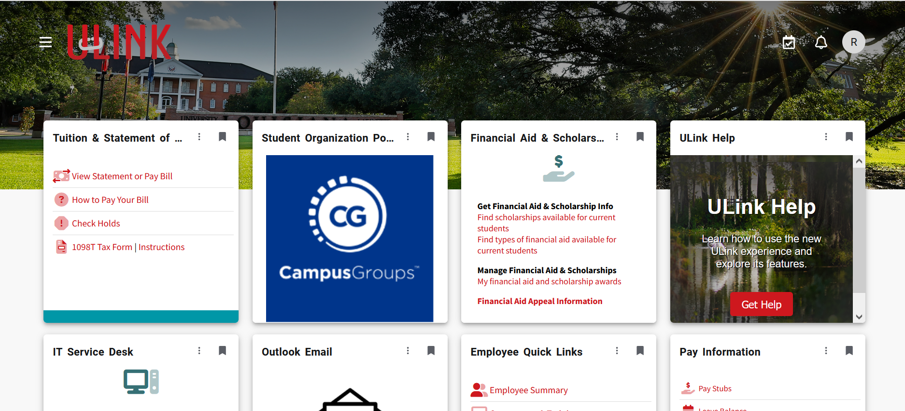
Go to the Tuition and Statement of Account card

Slide 3
Click on View your statement or pay your bill

Slide 4
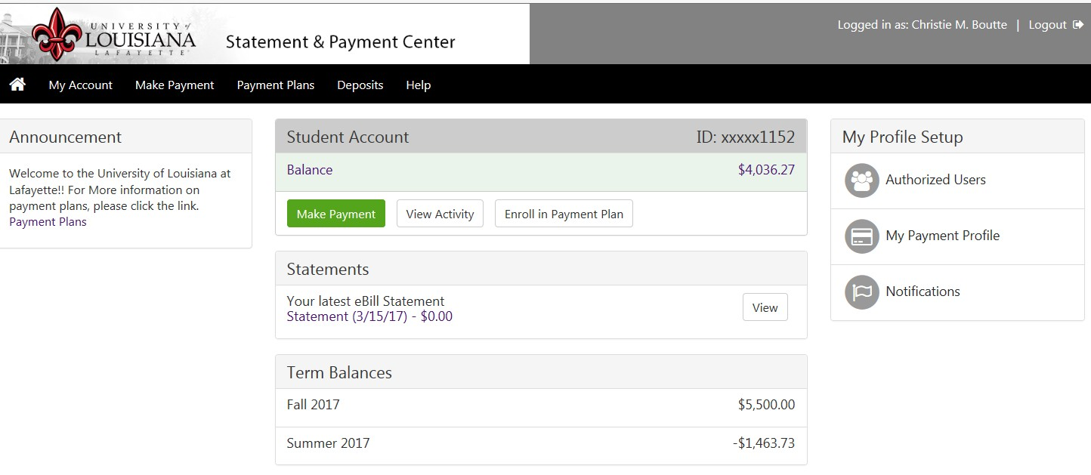
Welcome to the Statement and Payment Center Click on the Deposits tab

Slide 5
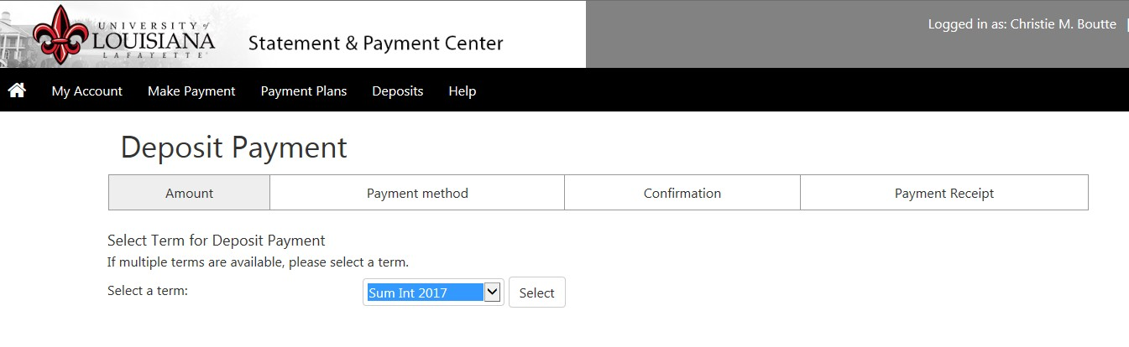
Select Summer Intercession for Costa Rica Select Summer for England-EN, France-FR, Italy-IT, Ireland-IR & Morocco-MR

Slide 6
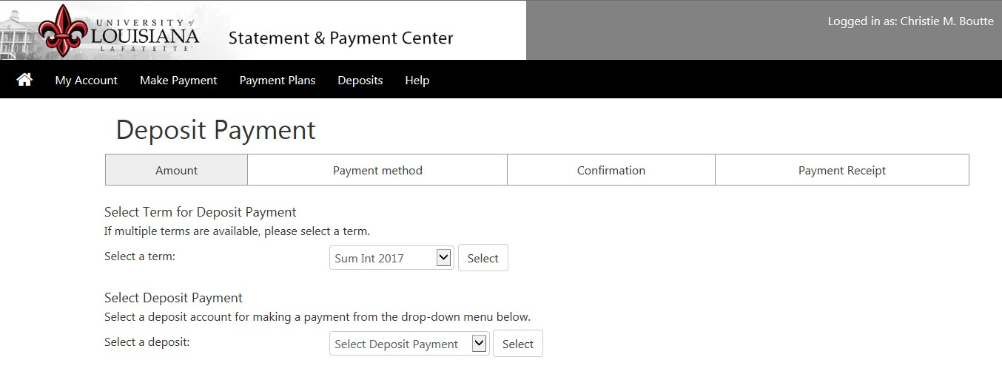
Select the deposit you would like to make by clicking the arrow then click Select

Slide 7
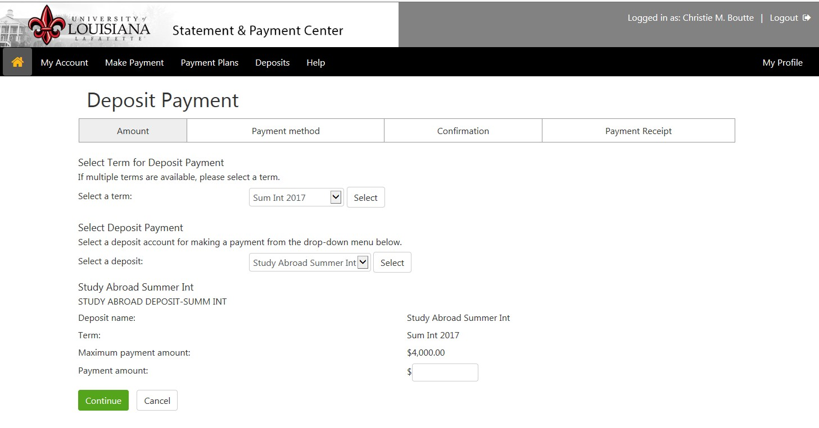
Enter the amount you would like to deposit

Slide 8
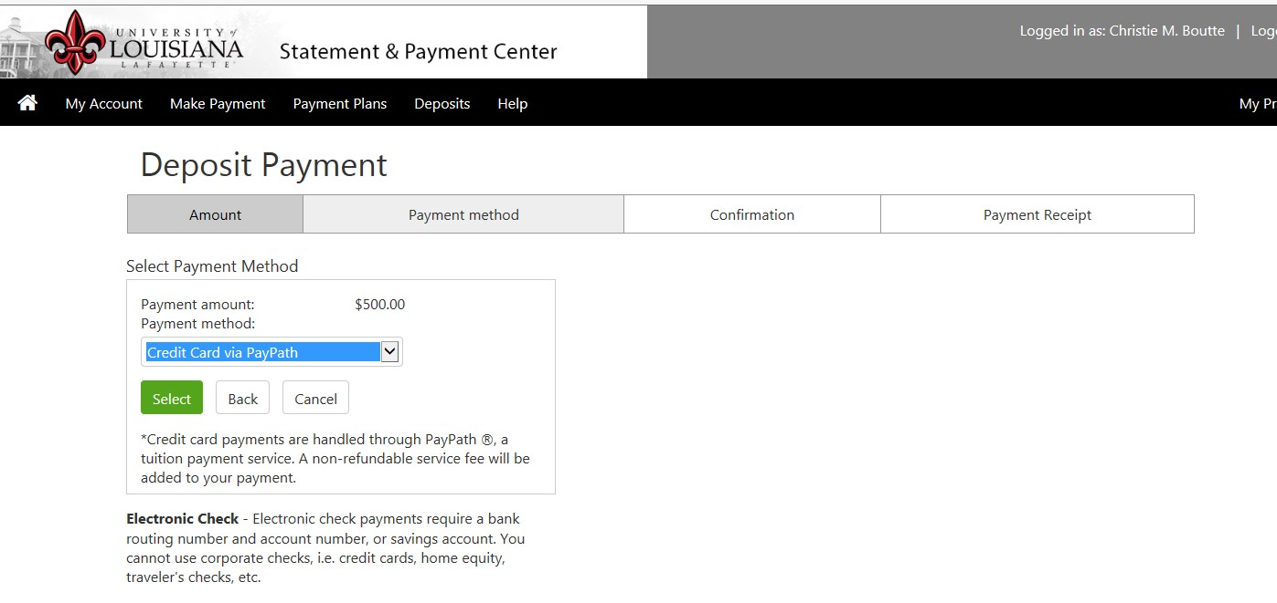
Select the payment method by click the arrow button next to Payment Method and clicking the Select button

Slide 9
How to pay with a Checking or Savings account
Please be careful when entering banking information. If your check does not clear the bank for any reason, you will be charged a $30 NSF fee and a hold will be placed on your account

Slide 10
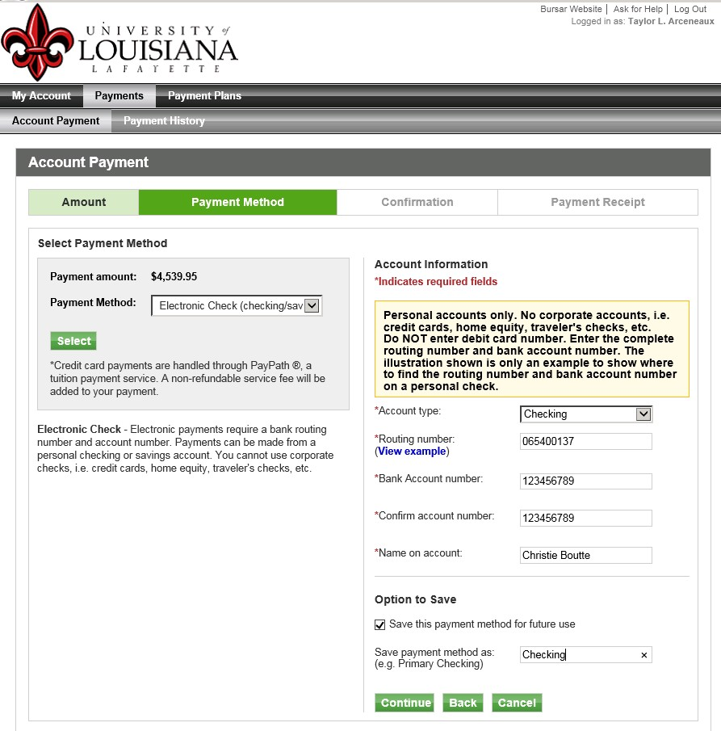

You can choose your account type by clicking the arrow. Choose either checking or savings account.
Enter your routing and account numbers in the fields designated by an asterisk *. Your account number must be entered twice to proceed.
Then enter the name as it appears on your checking account.
By clicking the box next to Option to save, your account information will be saved in the program to be used at a later time.
Make sure you name your payment method
Click the
button to proceed.

Slide 11
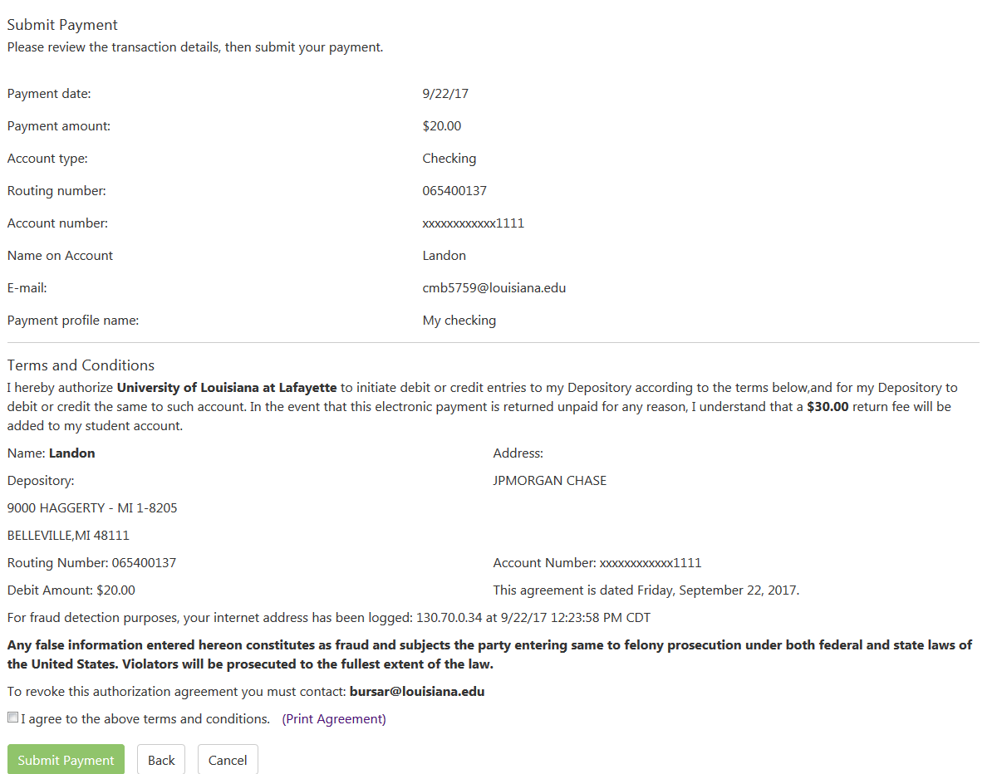
.
You have 10 minutes to complete the payment.

Slide 12
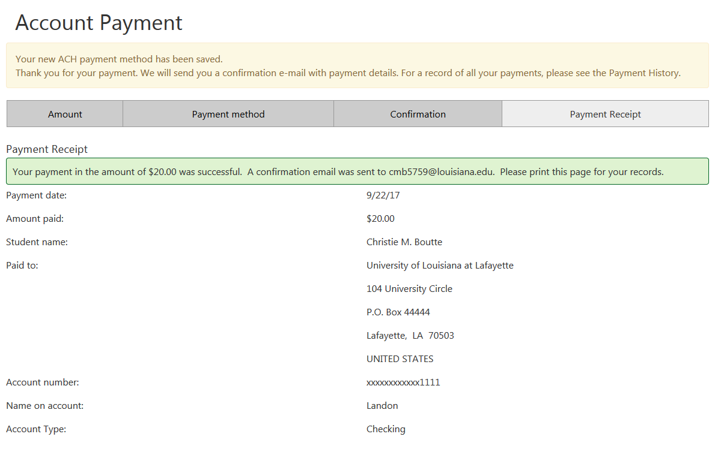

Slide 13
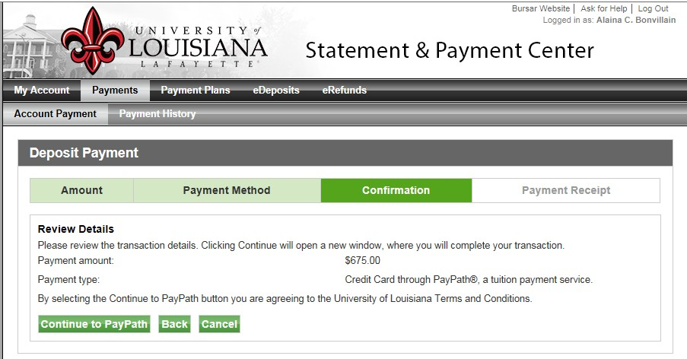
This page is confirmation that you are ready to make a payment

Slide 14
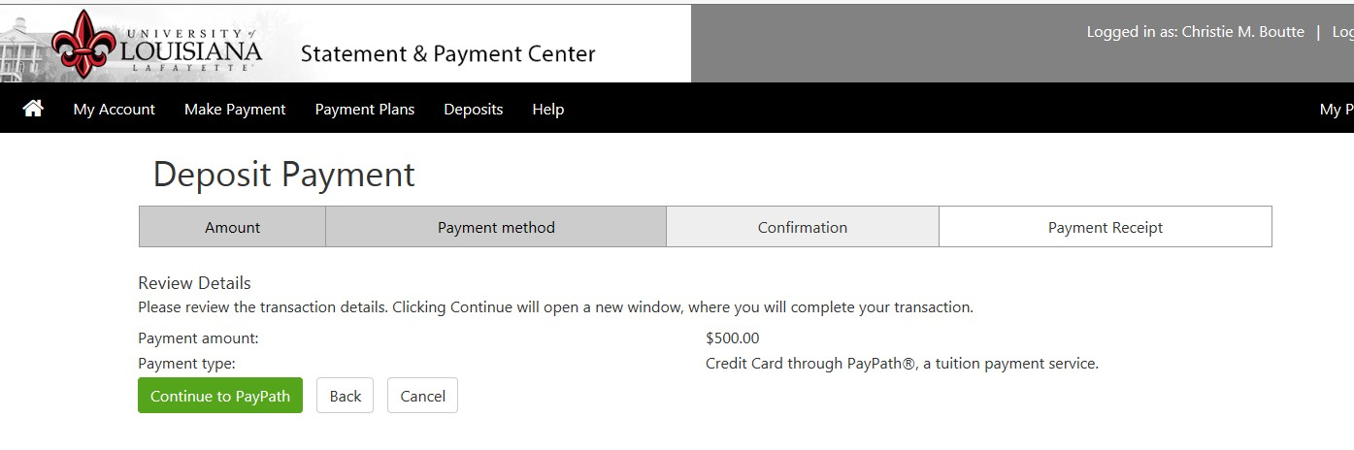
By choosing to pay with a credit card, an additional 2.95% (minimum of
$3) will be added to your payment. Click the Continue button if you are ready to make your payment
If you choose to pay with an electronic check, there will not be any additional fees charged

Slide 15
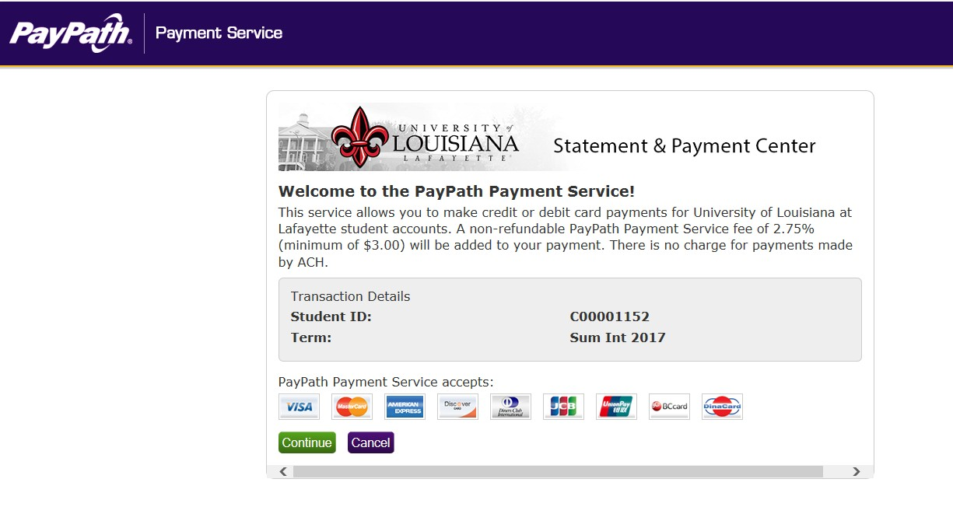
If paying with a credit card a confirmation page will come up, if you agree to pay the additional service fee of 2.95%, then click Continue.

Slide 16
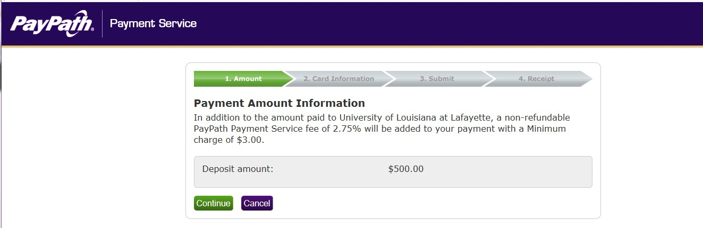
If paying with a credit card a second confirmation page will come up, if you agree to pay the additional service fee of 2.95%, then click Continue.

Slide 17
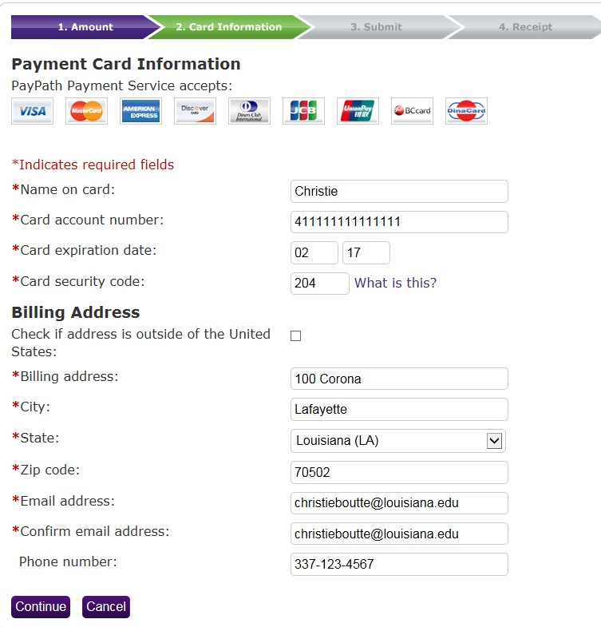
Enter credit card information and click Continue

Slide 18
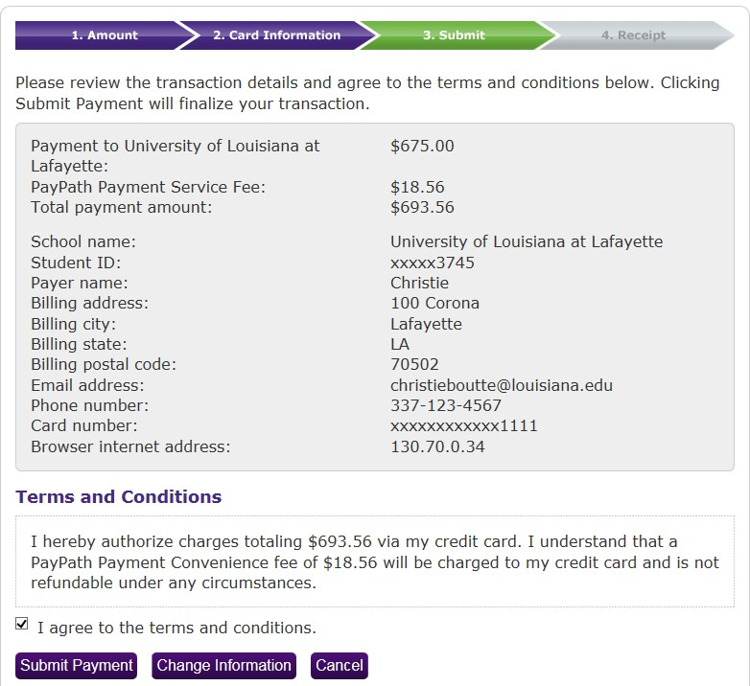
Check the box to agree to the Terms and Conditions and click Submit Payment

Slide 19
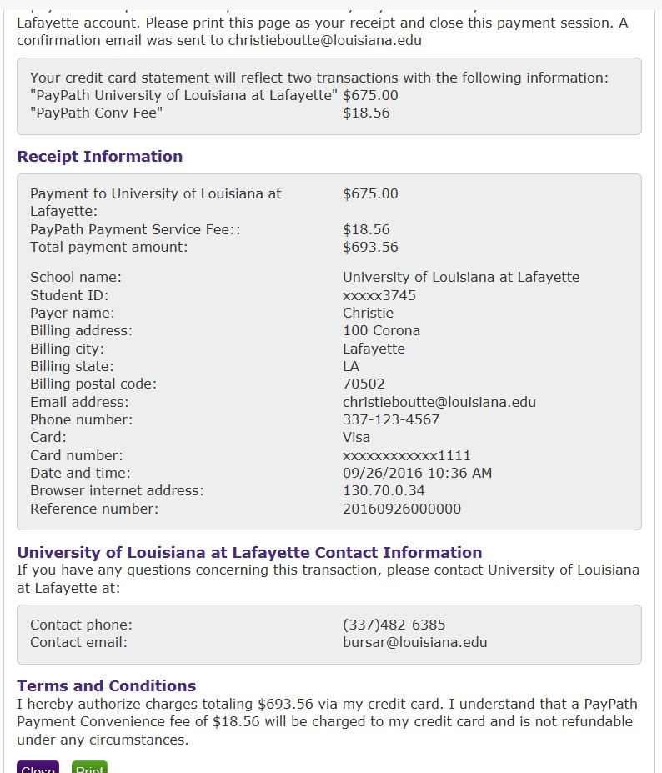
Your receipt will appear, if you would like to print your receipt, click the Print button, if not click Close. Please keep a copy of your receipt. You will not be able to view your deposit on your account

Slide 20
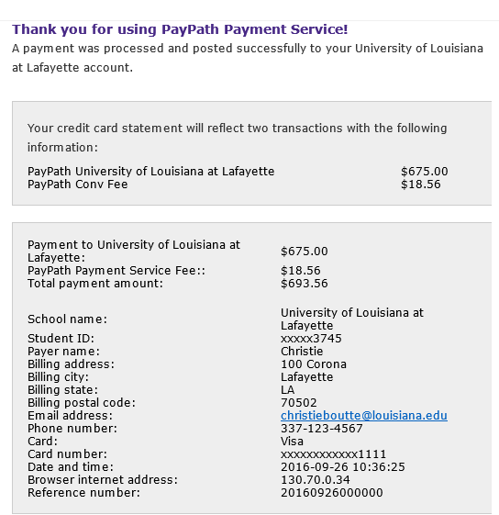
You will receive a confirmation email that looks like this. Please keep a copy of your receipt. You will not be able to view your deposit on your account

Slide 21
THE END

